Slide 1
Flexible and Wearable sensors for health monitoring applications
Reva Teotia (2019A3PS0268P)

Slide 2
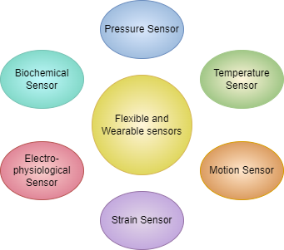
Introduction
Wearable devices for continuous and remote health monitoring.
Requirements
Light weight
Flexible
Biocompatible
Applications
Pulse rate measurement
Motion detection
Glucose, pH and other biological indicators detection
Physiological signal like EEG, EMG, ECG monitoring

Slide 3
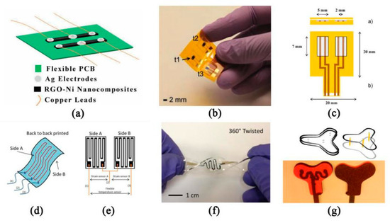
Temperature Sensors
Temperature sensors are vital for monitoring the body temperature. Temperature outside the normal range can be critical for the health.
Transduction mechanism
Flexible resistance temperature detector (FRTD)
Thermistors
Thermocouple

Slide 4
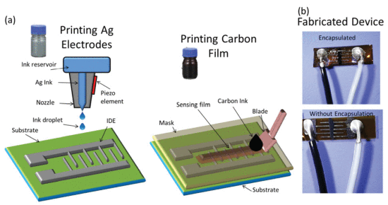
Temperature Sensors
Flexible resistive temperature detector (FRTD)
Change in temperature cause a change in electrical resistance.
Temperature coefficient of resistance (TCR) = (ΔR/R₀)/ΔT
Sensitivity S = ΔR/R₀
Active material - Metals like Ni, Cu, Pt
Carbon derivatives - CNT, graphene, quantum dots
Conducting polymers - PEDOT:PSS
Fabrication methods -
Laser Digital Printing (LDP)
Inkjet printing
Sputtering
Spin coating

Slide 5
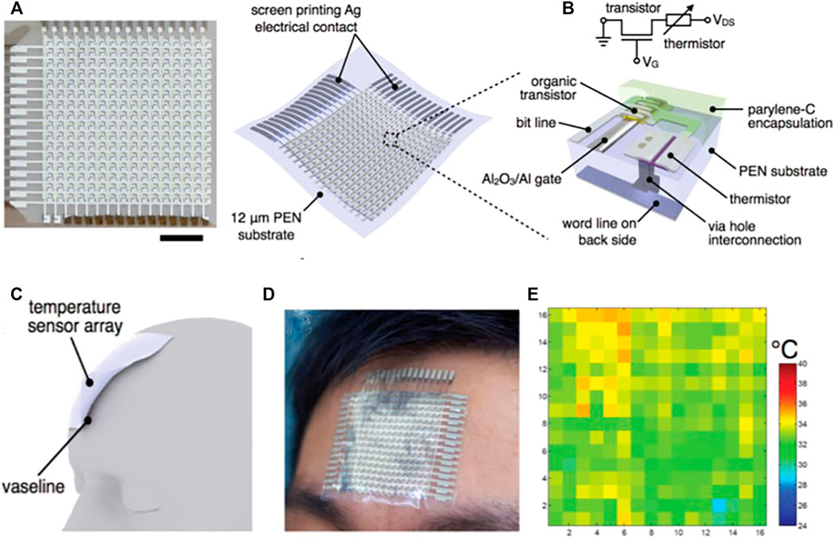
Temperature Sensors
Thermistors
The resistance changes occurs due to change in temperature.
Active material - Metals like Pt, Cu, Ag, Au, AgNW
Carbon derivatives like rGO, CNT, graphene
Substrate - PI, PDMS, PET, PEN
Fabrication methods -
Inkjet printing
Sputtering
Spin coating

Slide 6
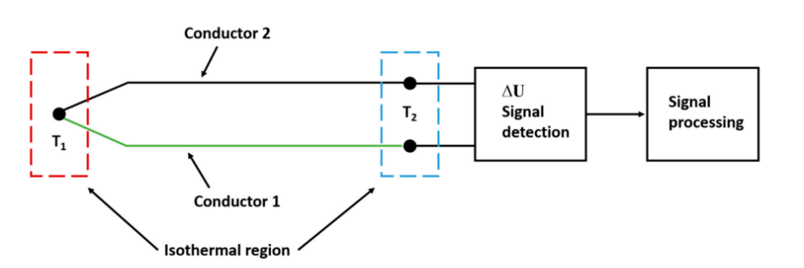
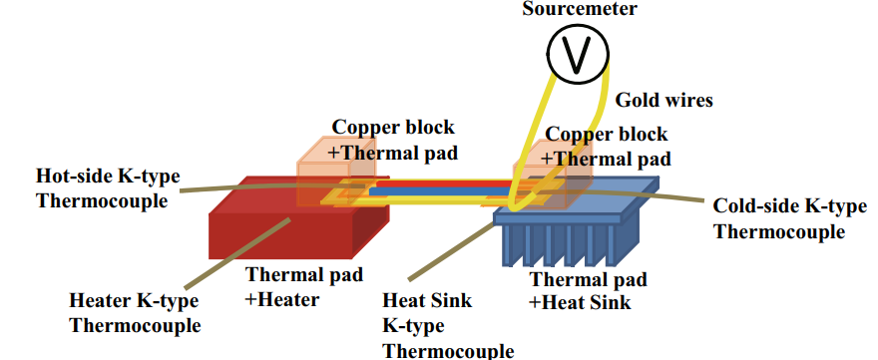
Temperature Sensors
Thermocouples
Seebeck effect - production of emf in two dissimilar conductors when the junctions are maintained at different temperatures.
Active material - alloy films
nickel-aluminum-silicon-manganese alloy film,
nickel-aluminum alloy film,
p-Sb2Te3 film, n-Bi3Te3 film, Bi-Te film and Sb-Te film
Fabrication methods -
Sputtering
Spin coating

Slide 7
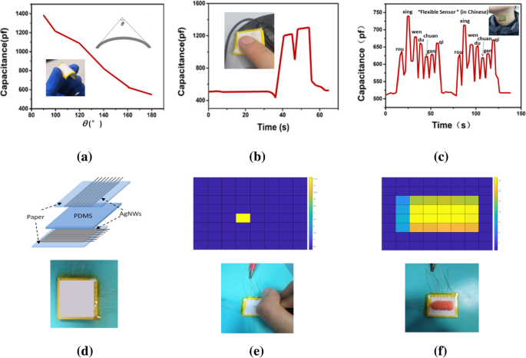
Pressure Sensors
Pressure sensors can be used for determining pulse, blood pressure or external pressure applied on e-skin or prosthetics.
Transduction mechanism
Capacitive
Piezoelectric
Piezoresistive

Slide 8
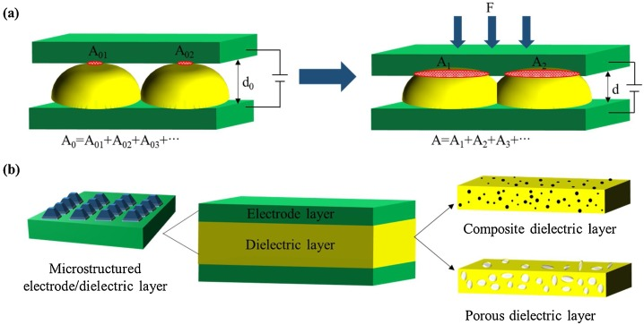
Pressure Sensors
Capacitive Pressure sensor
C = 𝜀_{r}𝜀₀A/d
Where 𝜀_{r} is the relative permittivity, A is the plate area and d is the gap between plates.
Active material - dielectric material - PDMS, PU, organosilicon elastomer, polystyrene, PET, woven-spacer structures
Microstructures are created to enhance sensitivity.

Slide 9
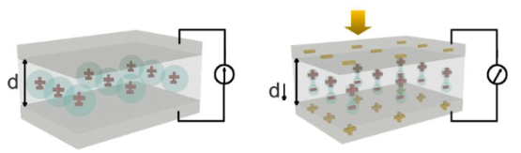
Pressure Sensors
Piezoelectric Pressure sensor
Piezoelectric effect - The application of external pressure that cause deformation generates current and vice versa.
Active material - P(VDF-TrFE)),barium titanate (BaTiO3), lead zirconate-titanate (PZT), and zinc oxide (ZnO)

Slide 10
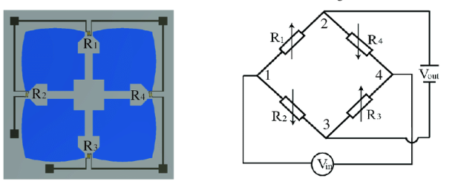
Pressure Sensors
Piezoresistive Pressure sensor
Piezoresistance - Deformation in the structure cause change in electrical resistance.
Active material - metallic particles, metal NW
carbon-based materials including carbon black, CNTs, and reduced graphene oxide (rGO)

Slide 11
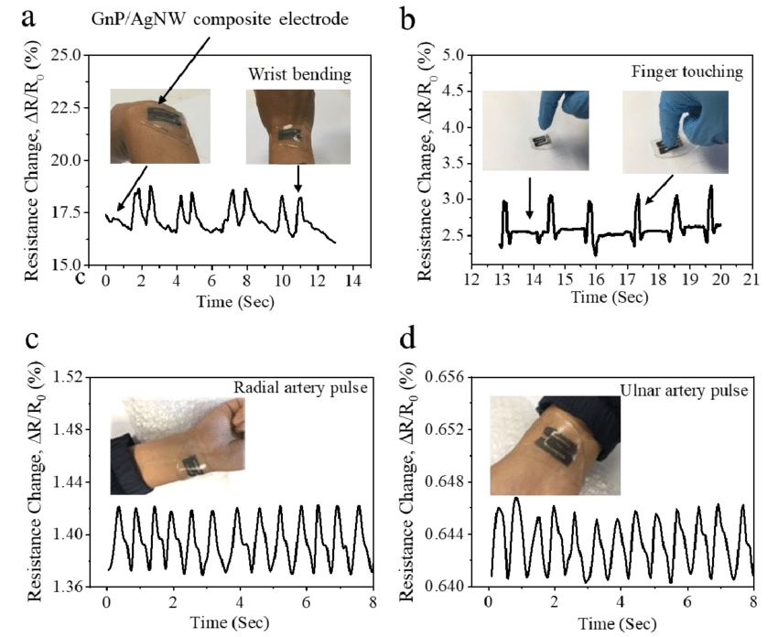
Strain Sensors
Strain is the relative change in the length of a structure under stress.
Strain sensors convert mechanical stimuli into optical or electrical signals.
Application - Recognize the posture or gesture
Continuous blood pressure monitoring
Artificial tactile sensation
Vocal-cord vibrations
Pulse
Respiration
Transduction mechanism
Piezoresistive
Capacitive
Piezoelectric

Slide 12
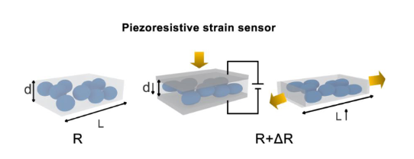
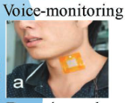
Strain Sensors
Piezoresistive Strain sensor
Tensile strain
Gauge factor (GF) = (ΔR / R0) / ε, that is, the fractional
change in the resistance, with ε being the strain
Compressive strain
Sensitivity = (ΔE / E0) / ΔP. where ΔE represents the change in the electrical signals
Active material - CNT, graphene, carbon black, polymers, metal nanowires
Advantages - simple structure, low cost, high linearity and excellent sensing performance

Slide 13
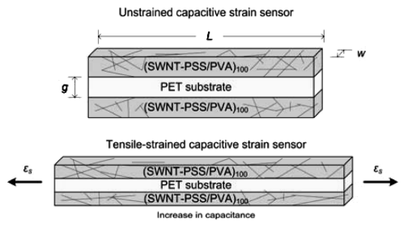
Strain Sensors
Capacitive Strain sensor
Gauge factor, GF = (∆C / C0) / ε
Active material - dielectric material - elastomers, ionic liquid/gels, thinned inorganic material
Advantages - Low input energy,
High dynamic response and
Low noise impact

Slide 14
Strain Sensors
Piezoelectric Strain sensor
These can be used as a generator as well as the biosensor.
Evaluated in either of the two working modes -
open circuit voltage (V_{oc})
Short circuit current (I_{sc})
Active material - ZnO, PZT nanoribbons, BaTiO3, and organic polymer like PVDF

Slide 15
Thank You

